Slide 1

Introduction to Data Analytics
ITE 5201
Lecture8-Outliers
Copy right:@ https://pub.towardsai.net/outlier-detection-and-treatment-9a9f41df0fb2

Slide 2
What are Outliers?
What are Outliers?
An outlier is that datapoint or observation which behaves very differently from the rest of the data.
Example:
If we are finding the average net worth of a group of people, and if we find Elon Musk in that group, then the complete analysis will go wrong because of just one outlier. This is a reason why outliers should be treated properly before building a machine learning model.

Slide 3
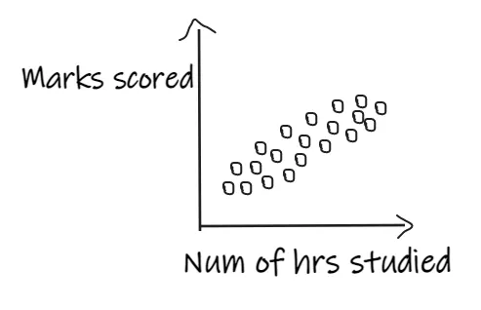
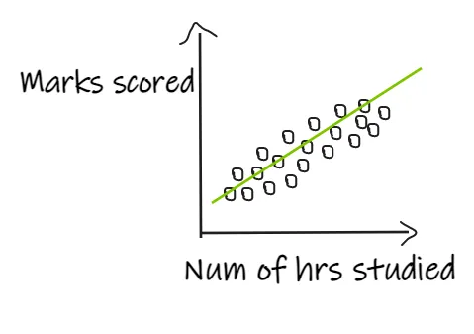
Outliers in linear Regression
If we are building a linear regression model, which has an independent feature, ‘Num of hours studied’, and the dependent feature, ‘marks scored’, and if the data is distributed as shown below, then the model will perform well.

Slide 4
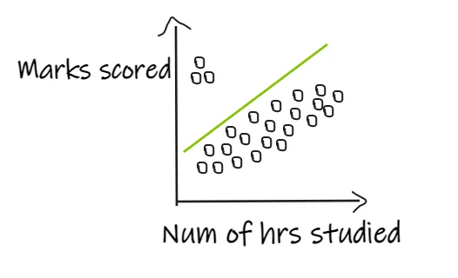
Outliers in linear Regression
If we have 3 students who scored good marks even after studying for fewer hours, then the regression line shifts in order to fit the outlier points as shown below, resulting in giving bad results to the actual data.

Slide 5
Outliers in Machine learning algorithm
Machine learning algorithms in which the calculation of weight is involved, like linear regression, logistic regression, Ada boost, and deep learning models, will get impacted by the outliers.
Tree-based algorithms like Decision trees, Random Forest will get less impacted by outliers.

Slide 6
Outlier Treatment
Trimming: Remove the outliers from the dataset before training a machine learning model. E.g., Remove the students from the dataset in the above example.
Capping: Keep a maximum or minimum threshold and give values to the data points accordingly. E.g., if we are working on the age feature, we can keep the threshold of 85 and assign the value of 85 to all the people with age greater than 85.
Discretization: This is the method in which numerical features are converted to discrete using bins. E.g., if the age 80–90 is considered as a single bin, then all the ages between 80 and 90 will be treated equally.

Slide 7
Outlier Detection and Removal Techniques:
1. Z Score-based method
1. Z Score-based method
The main assumption in this technique is that the data should be normally distributed or close to normal distribution.
If the data is normally distributed, the Empirical Rule says that 68.2% of the data points lie in between the 1st standard deviation, 95.4% of the data points lie in between the 2nd standard deviation, and 99.7% of the data points will be between the 3rd standard deviation.

Slide 8
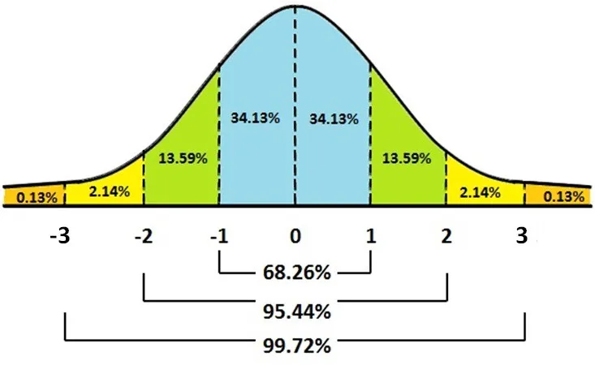
Z Score-based method
Data points that lie outside the 3rd standard deviation can be treated as outliers.
As 99.7% of the data will lie within the 3 standard deviations, we can treat the rest of the data which lie outside the 3 standard deviations as outliers.

Slide 9
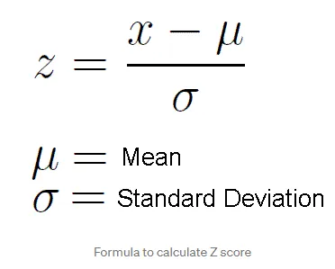
Standardization or Z-Score Normalization
Standardization or Z-Score Normalization is one of the feature scaling techniques, here, the transformation of features is done by subtracting from the mean and dividing by standard deviation.
This is often called Z-score normalization. The resulting data will have the mean as 0 and the standard deviation as 1.

Slide 10
Treatment
Outlier Treatment:
Trimming: In this method, we can remove all the data points that are outside the 3 standard deviations.
Capping: In this method, the outlier data points are capped with the highest or lowest values
Let us look at the practical implementation of this technique.

Slide 11
2. IQR technique
This method is used when the distribution of the data is skewed.
The IQR describes the middle 50% of values when ordered from lowest to highest. To find the interquartile range (IQR), ​first, find the median (middle value) of the lower and upper half of the data. These values are quartile 1 (Q1) and quartile 3 (Q3). The IQR is the difference between Q3 and Q1.
IQR = Q3-Q1
Minimum value = Q1–1.5 *IQR
Maximum value = Q3+1.5*IQR

Slide 12
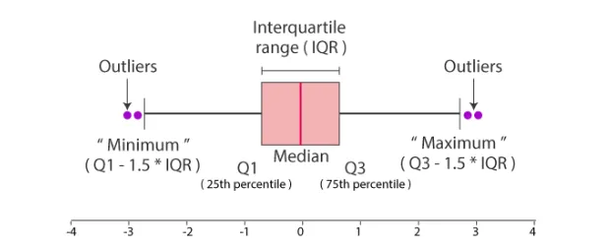
IQR technique
The data points which are lesser than the minimum value and the data points which are greater than the maximum value are treated as outliers.
Let us look at the practical implementation of this technique.

Slide 13
3. Percentile Method
Percentiles are fundamentally different from percentage scores. Percentiles are best explained through examples
If a candidate scores in the 50th percentile, this means that the candidate has scored higher than 50% of the norm group (i.e they got a score which is exactly in the middle of what everyone else got).
If a candidate scores in the 90th percentile, they have scored higher than 90% of the norm group, putting them in the top 10%.
If a candidate scores in the 10th percentile, they have scored higher than 10% of the norm group, putting them in the bottom 10%.

Slide 14
Percentile Method
This is one of the simplest techniques used to detect the outliers in a dataset. We need to just decide the threshold, Eg, if we decide 1 percentile, then it means we treat all the values above 99 percentile and below 1 percentile as outliers.
Let us look at how we can implement this method practically.

Slide 15
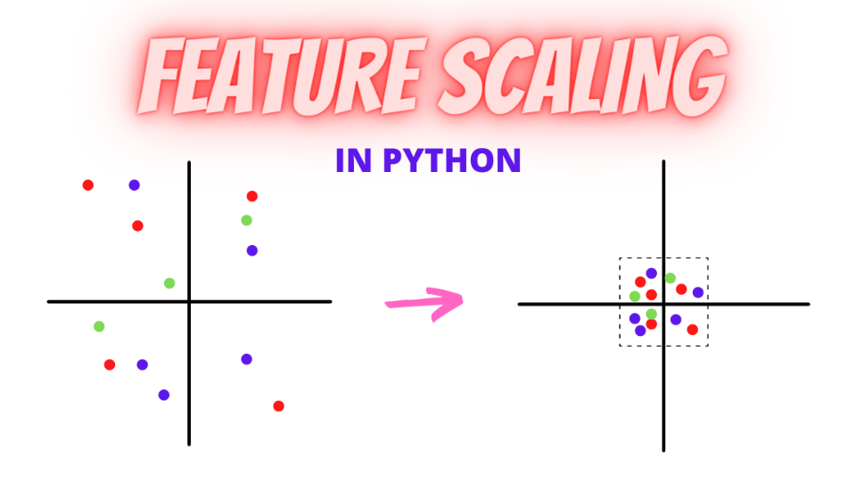
Feature Scaling
And Feature Scaling is one such process in which we transform the data into a better version.
Feature Scaling is done to normalize the features in the dataset into a finite range.

Slide 16
Feature Scaling Techniques
There are several ways to do feature scaling. I will be discussing the top 5 of the most commonly used feature scaling techniques.
Min-Max Scaling
Normalization-Mean Normalization
Robust Scaling
Absolute Maximum Scaling
Standardization-Standard Scaler

Slide 17
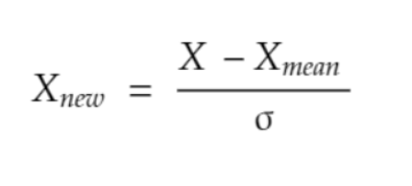
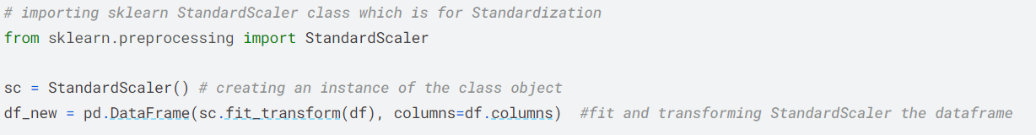
Standardization
In standardization, we calculate the z-value for each of the data points and replaces those with these values.
This will make sure that all the features are centred around the mean value with a standard deviation value of 1. This is the best to use if your feature is normally distributed like salary or age.

Slide 18
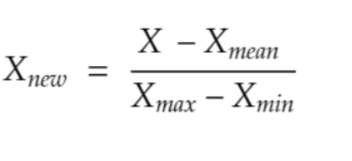
Normalization
Mean Normalization
In scaling, you are changing the range of your data while in normalization you arere changing the shape of the distribution of your data.
It is very similar to Min Max Scaling, just that we use mean to normalize the data. Removes the mean from the data and scales it into max and min values.
Scikitlearn does not have any specific class for mean normalization. However, you can do this very easily using numpy.

Slide 19
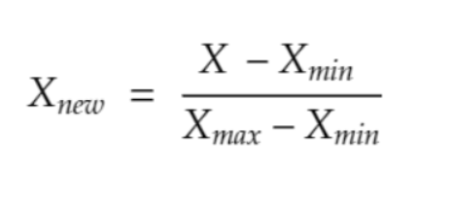
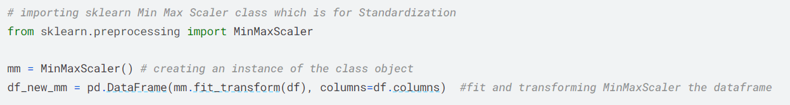
Min Max Scaling
In min-max you will subtract the minimum value in the dataset with all the values and then divide this by the range of the dataset (maximum-minimum).
In this case, your dataset will lie between 0 and 1 in all cases

Slide 20
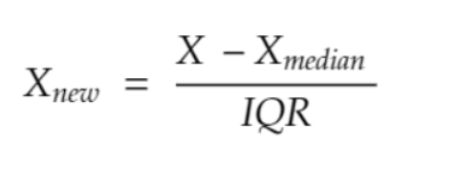
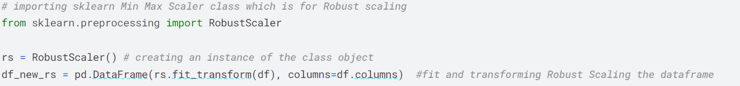
Robust Scaling
In this method, you need to subtract all the data points with the median value and then divide it by the Inter Quartile Range(IQR) value.
IQR is the distance between the 25th percentile point and the 50th percentile point.
This method centres the median value at zero and this method is robust to outliers.

Slide 21
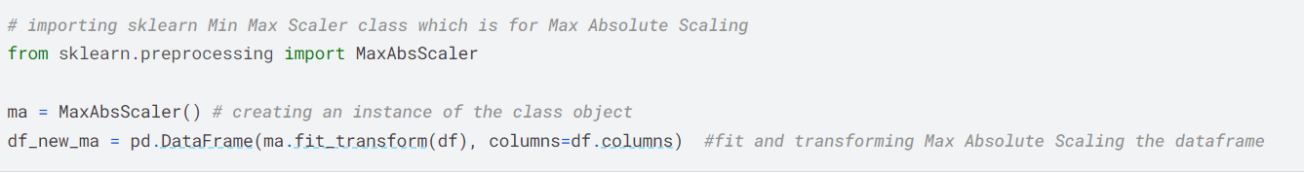
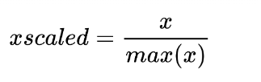
Absolute Maximum Scaling
Find the absolute maximum value of the feature in the dataset
Divide all the values in the column by that maximum value
The main disadvantage is that the technique is sensitive to outliers

Slide 22
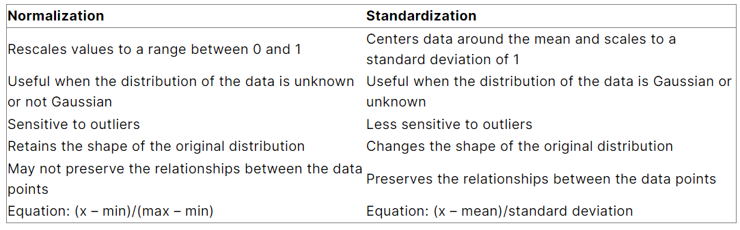
The Big Question – Normalize or Standardize?

